Slide 1



Haramaya University
Haramaya Institute Of Technology
School Of Electrical And Computer Engineering
Internship Report
Hosting Company : INSA
Abdi Geremu 0281/12
Ababiya Tujuma 0297/12
Mahilet Workineh
Seid Jemal
Yared Debebe
Notes:
Drag & Drop to add a picture in the back placeholder

Slide 2
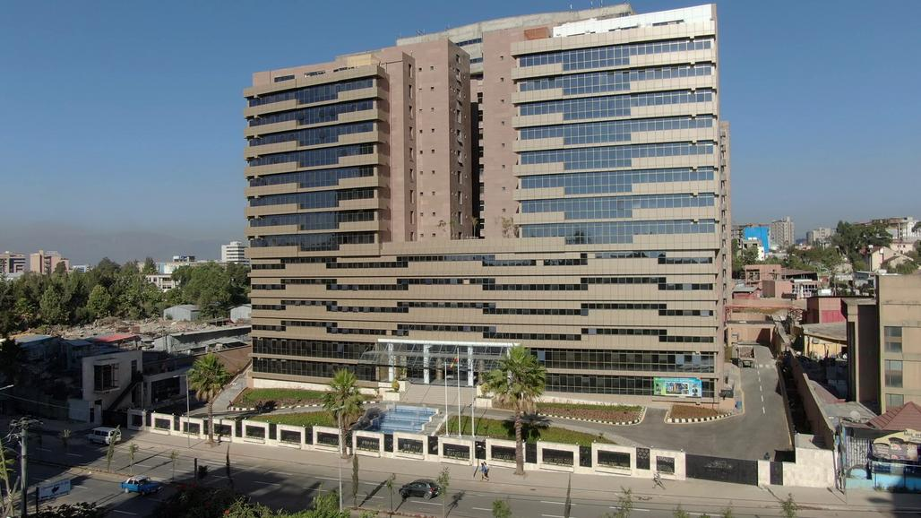
Introduction – INSA Background
01
INSA was first established in 2006(GC) by Council of Ministers.
The goal is to defend the nation's information and information infrastructure from attack.
Operates a Talent Academy named as “Ethio-Cyber Talent”
The Talent center is dedicated to imparting technology and focusing on cyber security , Software and Hardware Development.
Notes:
Drag & Drop to add a picture in the placeholder

Slide 3
Mission
02
To build national cyber power capable of protecting the national interest.
To provide technical intelligence pertaining to national interest so as to support decisions and actions of the government.
To build data and computing capacity so as to ensure the transformation of the national high-tech and security industry.
To ensure that information and computer based key infrastructures are secured so as to be enable of national peace, democratization and development program
Notes:
Drag & Drop to add a picture in the placeholder

Slide 4
Vision
03
To see a globally competent National Cyber Security Institution that plays a key role in the renaissance of the country.
To realize a globally competent National Cyber capacity which plays a key role in protecting the national interests of Ethiopia
Notes:
Drag & Drop to add a picture in the placeholder

Slide 5
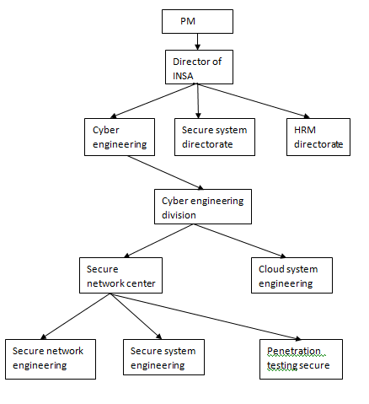
Organization Structure and Work flow
05
Notes:
Drag & Drop to add a picture in the placeholder

Slide 6

Internship Projects
Design Of Enterprise Networking
Microsoft Exchange Server Deployment
Notes:
Drag & Drop to add a picture in the back placeholder

Slide 7

Exchange Server Deployment
07
Is a mail server and calendaring server developed by Microsoft.
Exchange initially used the X.400 directory service but switched to Active Directory later.
Active Directory is Directory Service that serves as a centralized system for authentication and authorization to network resources.
The standard SMTP protocol is used to communicate to other Internet mail servers.
Notes:
Drag & Drop to add a picture in the placeholder

Slide 8
…Exchange Server Deployment
08
Exchange Server 2013 Installation
Hardware Requirements
At least 30GB on server’s disk
At least 8GB memory space (RAM)
X64 architecture-based Computer.
Notes:
Drag & Drop to add a picture in the placeholder

Slide 9
…Exchange Server Deployment
09
Software Requirements
Active Directory Preparation
Window Server 2012 operating system.
Microsoft Office 2010 Filter Pack SP1 64 bit.
Microsoft Office 2010 Filter Pack 64 bit software.
Install the Microsoft Unified Communications
Notes:
Drag & Drop to add a picture in the placeholder

Slide 10
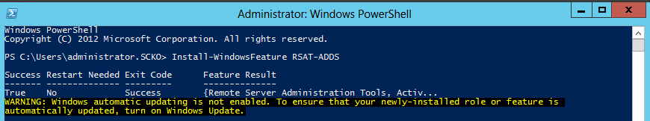
…Exchange Server Deployment
10
Installation Steps :
Powershell Command:
Install-WindowsFeature RSAT-ADDS
Notes:
Drag & Drop to add a picture in the placeholder

Slide 11
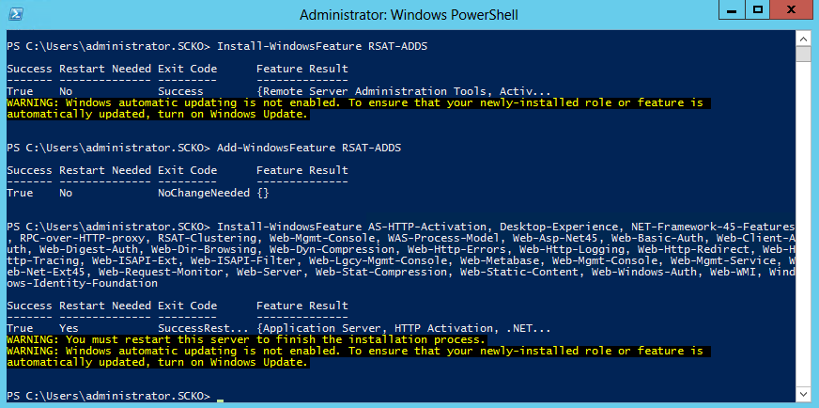
…Exchange Server Deployment
11
2. Windows Server 2012 prerequisites for Mailbox Server Role
3. Windows Server 2012 prerequisites for standalone Mailbox Server Role or Mailbox and Client Access Server role
Notes:
Drag & Drop to add a picture in the placeholder

Slide 12
…Exchange Server Deployment
12
2. Windows Server 2012 prerequisites for Mailbox Server Role
3. Windows Server 2012 prerequisites for standalone Mailbox Server Role or Mailbox and Client Access Server role
4.Download and Install the Microsoft Unified Communications Managed API 4.0, Core Runtime 64-bit software.
5. For Exchange Server 2013 preview, Microsoft Visual C++ 11 beta redistributable (x64) component should be removed from the system.
Notes:
Drag & Drop to add a picture in the placeholder

Slide 13
…Exchange Server Deployment
13
6. Download and Install the Microsoft Office 2010 Filter Pack 64 bit software.
7. Download and Install the Microsoft Office 2010 Filter Pack SP1 64 bit.
Notes:
Drag & Drop to add a picture in the placeholder

Slide 14
…Exchange Server Deployment
14
8. Prepare Active Directory and domains.
To execute the commands, the commands should be run using the Schema Admins group and the Enterprise Admins group membership
setup /PrepareSchema /IAcceptExchangeServerLicenseTerms
setup /PrepareAD /OrganizationName: /IAcceptExchangeServerLicenseTerms
9 . Install Exchange Server 2013 by clicking setup.exe
Notes:
Drag & Drop to add a picture in the placeholder

Slide 15
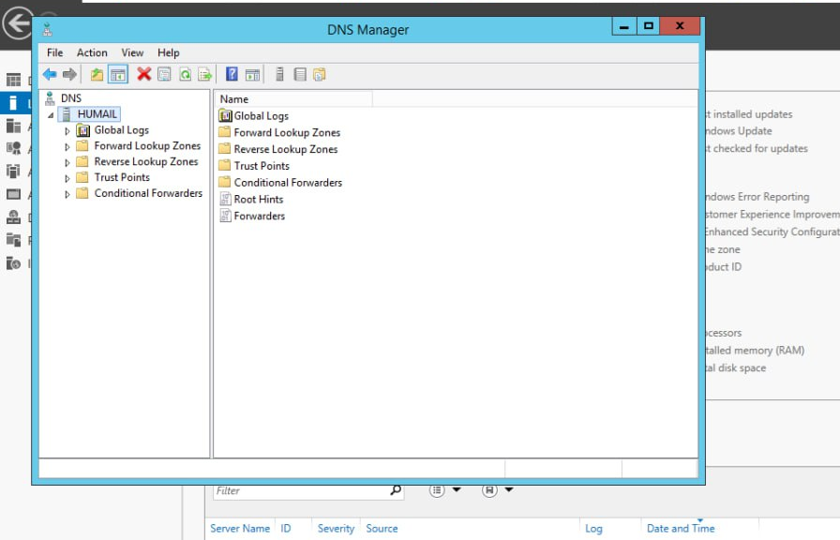
…Exchange Server Deployment
15
INTERNAL AND EXTERNAL URL CREATION
First we go to Forward DNS lookup zone and we create domain name for our external and internal URL.
We create domain name called “mail” and we concatenate to our exchange domain
Notes:
Drag & Drop to add a picture in the placeholder

Slide 16
…Exchange Server Deployment
16
Internal URL: is used to access the Exchange services from within the internal network
.
External URL :is used to access the services from outside the network
I.e, Internal URL: https://mail.huv.edu.et/ecp
https://mail.huv.edu.et/owa
External URL:https://mail.huv.edu.et/ecp
https://mail.huv.edu.et/owa
Note: Internal URL and External URL may not be always the same.
Notes:
Drag & Drop to add a picture in the placeholder

Slide 17
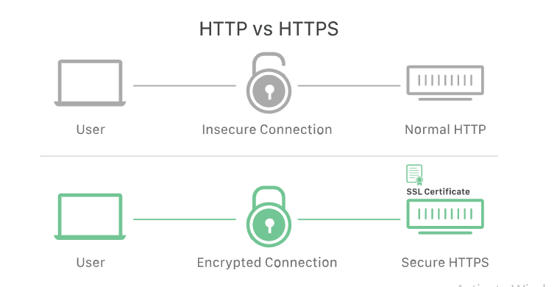
…Exchange Server Deployment
17
Certificate
An SSL certificate is a digital certificate that authenticates a website's identity and enables an encrypted connection.
SSL, or Secure Sockets Layer, is an encryption-based Internet security protocol.
Notes:
Drag & Drop to add a picture in the placeholder

Slide 18
…Exchange Server Deployment
18
Customization
Microsoft Exchange Outlook page is an open source mailing system.
We can customize the Outlook on the web (formerly known as Outlook Web App) sign-in, language selection, and error pages in Exchange Server.
Notes:
Drag & Drop to add a picture in the placeholder

Slide 19
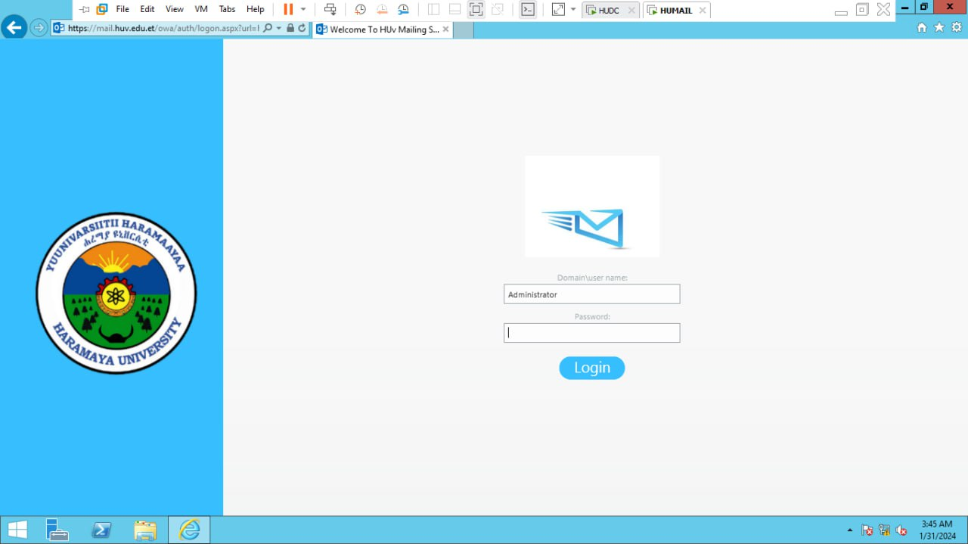
…Exchange Server Deployment
19
Outlook Owa sign in page customization preview
Notes:
Drag & Drop to add a picture in the placeholder

Slide 20
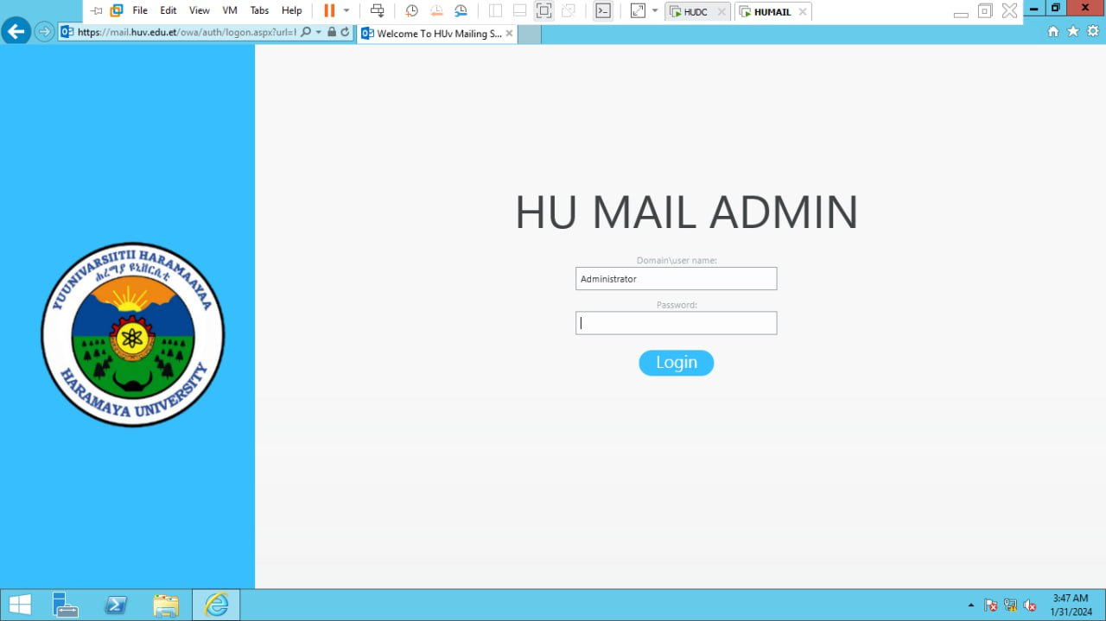
…Exchange Server Deployment
20
Outlook ECP sign in page customization preview
Notes:
Drag & Drop to add a picture in the placeholder

Slide 21

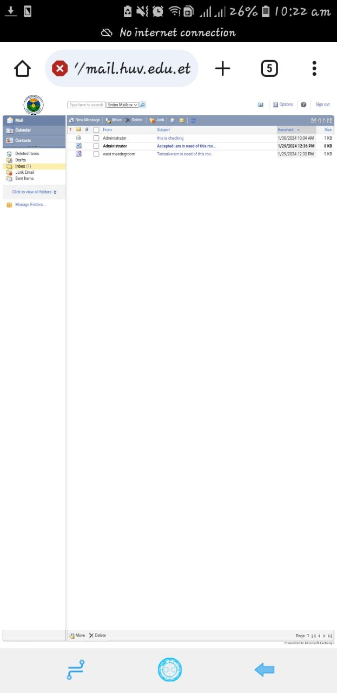
…Exchange Server Deployment
21
Outlook owa mobile sign in page customization preview
Outlook owa mobile message view page customization preview
Notes:
Drag & Drop to add a picture in the placeholder

Slide 22
…Exchange Server Deployment
22
Customization Recommendations
Language chooser page
Error page
Icon on Browser (Favicon)
Message view Page
Notes:
Drag & Drop to add a picture in the placeholder

Slide 23
Enterprise Network Design and Implementation
Objective: Design and implement a robust network for the enterprise ABC.
Tasks:
Develop network architecture.
Configure routers, switches, and firewalls.
Simulate the Design of Network Connection
Ensure seamless connectivity.
Collaborate with cross-functional teams.
Notes:
Drag & Drop to add a picture in the placeholder

Slide 24
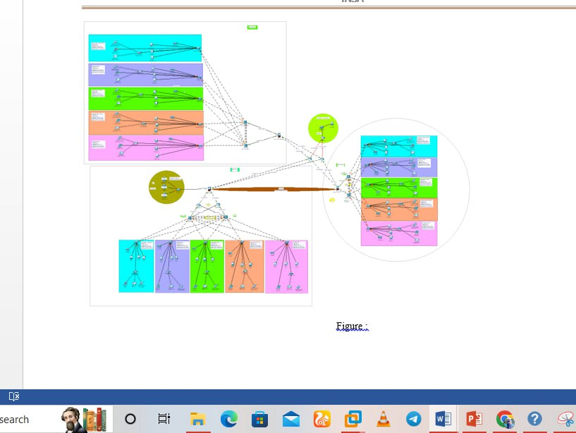
Enterprise Network Design and Implementation
24
Design of the company’s using cisco packet tracer.
Notes:
Drag & Drop to add a picture in the placeholder

Slide 25
Enterprise Network Design and Implementation
26
Subnnetting
is the process of creating a subnetwork (also known as a subnet) within a larger network.
makes networks more efficient by reducing unnecessary routing through redundant routers.
Routing
refers to the process of selecting the best path for data to travel from source to destination
.
Protocols help routers determine optimal routes for efficient data transfer.
OSPF is Used in this network design
A type of Link state protocol that share information with nighbouring routers.
Calculates routes base on path speed and resource cost.
Notes:
Drag & Drop to add a picture in the placeholder

Slide 26
Enterprise Network Design and Implementation
26
VLANS
Logical subnetwork that groups together devices from different physical Local Area Networks (LANs).
IP and Vlan plan of the Network design according to given requirement is:
Notes:
Drag & Drop to add a picture in the placeholder

Slide 27
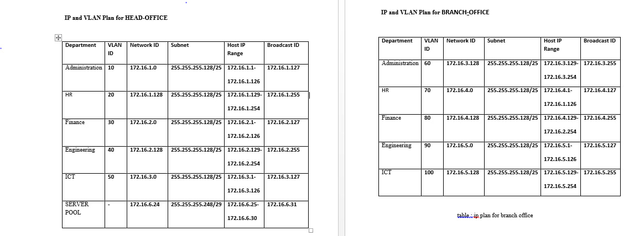
Enterprise Network Design and Implementation
27
Notes:
Drag & Drop to add a picture in the placeholder

Slide 28
Overall Experience Gained
28
Enterprise Network Design and Implementation
Routing and Switching
Firewall security Configuration
IP and Vlan Planning
Redundancy and STP configuration
VPN configuration
Microsoft Exchange Server
Installing and Configuring Servers
Manage Email communication andcollaboration
Powershell Scripting
Active Directory
Notes:
Drag & Drop to add a picture in the placeholder

Slide 29
Overall Experience Gained
29
Communication and Collaboration Skills:
Collaborated with cross-functional teams.
Enhanced professional communication.
Notes:
Drag & Drop to add a picture in the placeholder

Slide 30
Recommendation
30
Training Center at INSA is a good place to develop practical and useful theoretical knowledge.
Have good working Environment with clean area and reliable internet connection.
Good place to learn the value of time and develop social interation and communication skill.
What we recommend for this Training center is to make students participate in Active project in the organization.
Some Hardware materials need to be provide for smooth working conditions.
Notes:
Drag & Drop to add a picture in the placeholder

Slide 31

THANK
YOU

